Slide 1
Digital Logic &Design
Lecture 12

Slide 2
Half & Full Adders
Half Adder
Full Adder

Slide 3
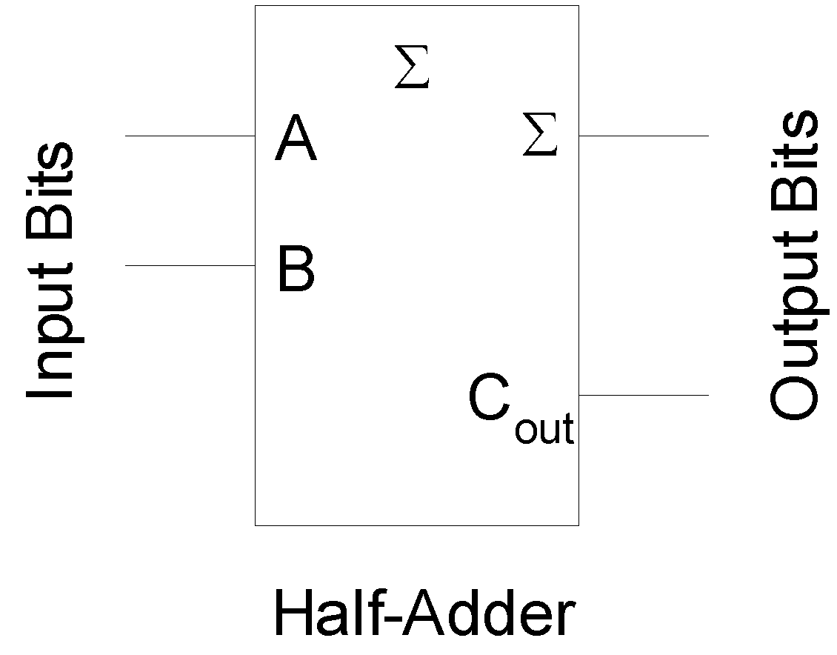
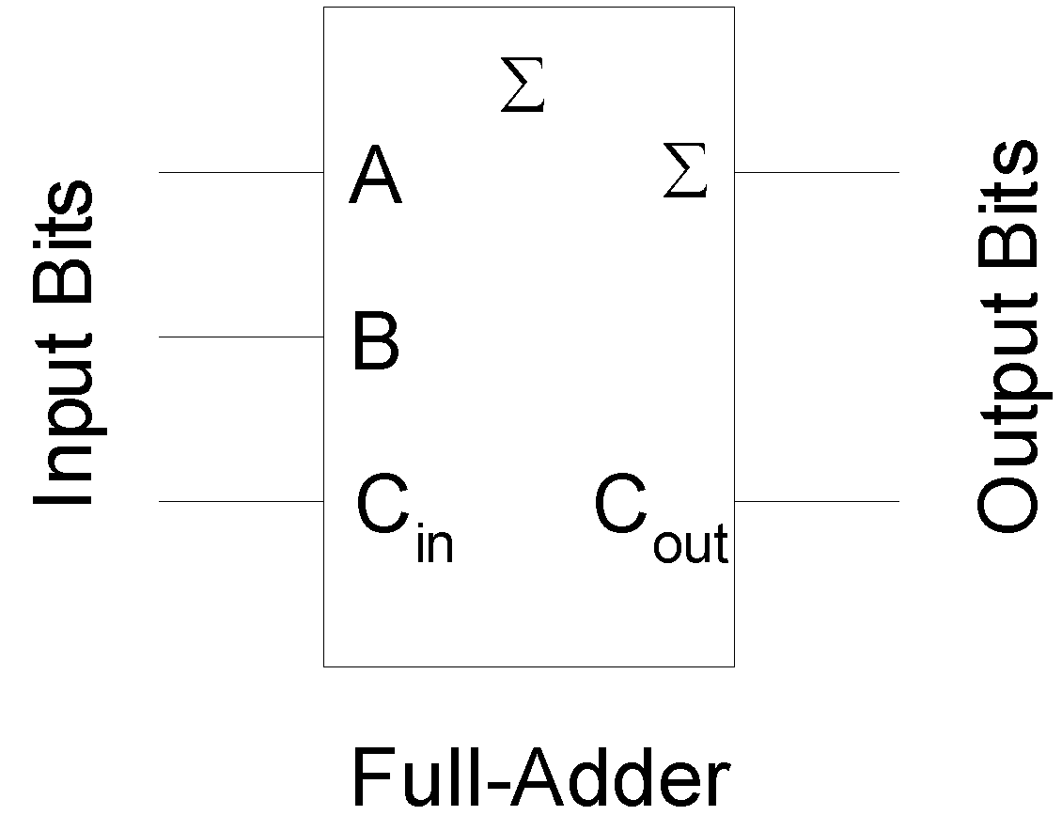
Half & Full Adders
Notes:
3
The block diagrams represent a Full-Adder and a Half-Adder.
A single bit binary adder circuit basically adds two bits and a carry bit, generated by the addition of the least significant bits. The output of the single bit adder circuit generates a sum bit and a carry bit.
An adder circuit that only has two bit input representing the two single bit numbers A and B and does not have the carry bit input from the least significant digit is regarded as a half-adder.
An adder circuit that has three inputs, two bits representing the two single bit numbers A and B, and the third bit represents the Carry in bit is regarded as a full-adder

Slide 4
Half-Adder
Function Table
Expression
Logic Circuit

Slide 5
Half-Adder Function Table
Input |  | Output
A | B | Sum | Carry Out
0 | 0 | 0 | 0
0 | 1 | 1 | 0
1 | 0 | 1 | 0
1 | 1 | 0 | 1

Slide 6


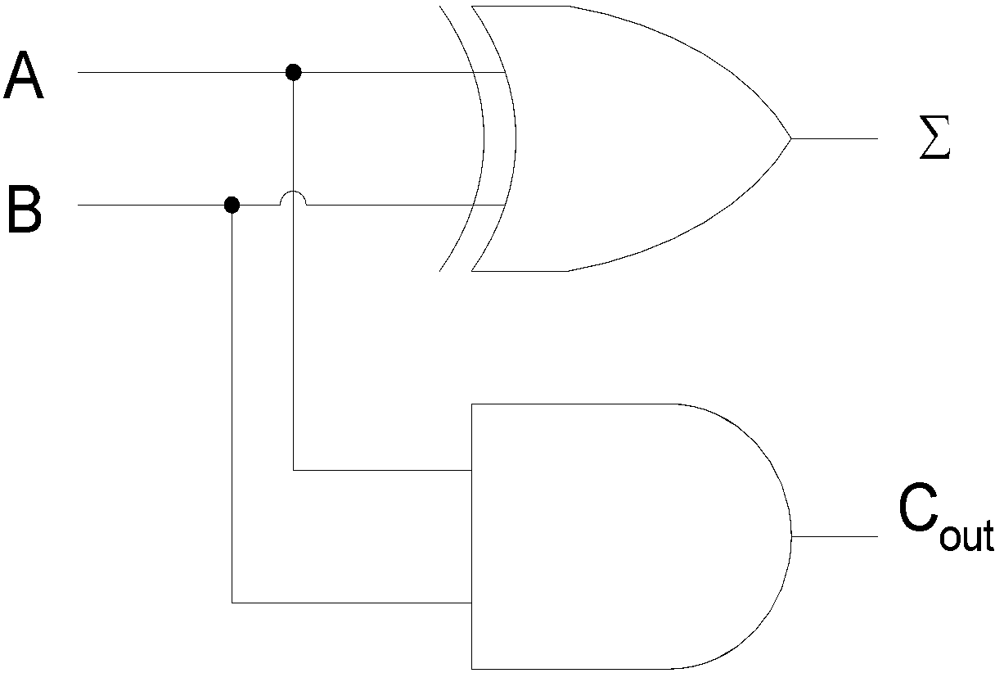
Half-Adder Circuit

Slide 7
Full-Adder
Function Table
Expression
Logic Circuit

Slide 8
Full-Adder Function Table
Input |  |  | Output
A | B | Carry In (C) | Sum | Carry Out
0 | 0 | 0 | 0 | 0
0 | 0 | 1 | 1 | 0
0 | 1 | 0 | 1 | 0
0 | 1 | 1 | 0 | 1
1 | 0 | 0 | 1 | 0
1 | 0 | 1 | 0 | 1
1 | 1 | 0 | 0 | 1
1 | 1 | 1 | 1 | 1

Slide 9




Sum Expression

Slide 10

Carry Out Expression

Slide 11
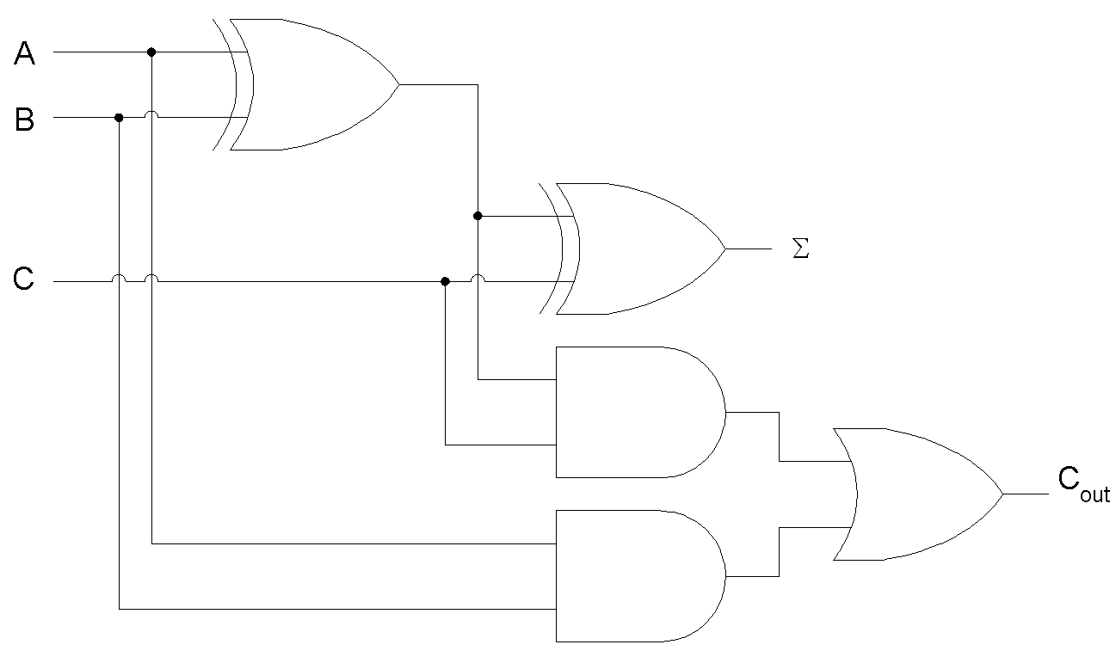
Full-Adder Circuit

Slide 12
Full-Adder
Full-Adder = Half-Adder + Half-Adder

Slide 13
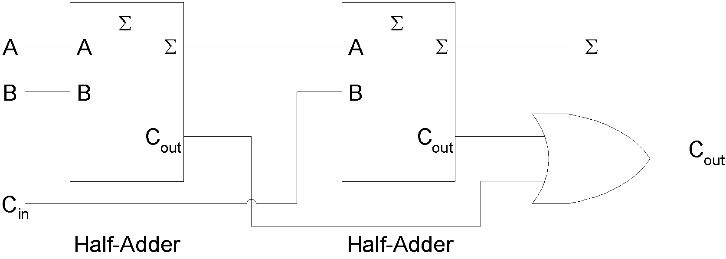
Full-Adder based on Two Half-Adders

Slide 14
Parallel Binary Adder
Multiple Single bit Full-Adder connected in Parallel

Slide 15
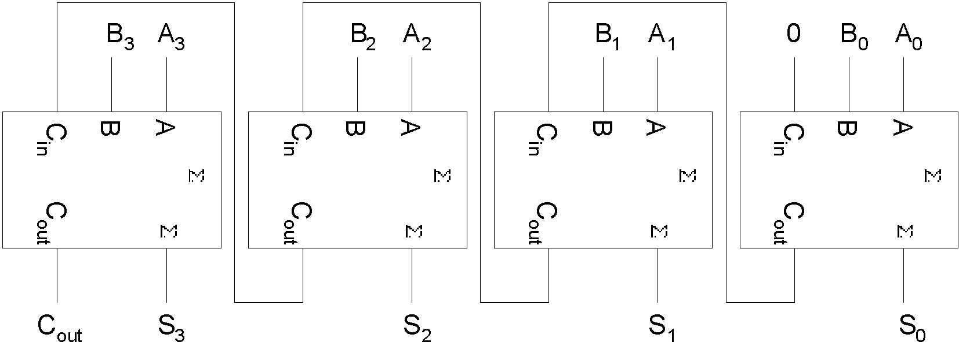
4-bit Parallel Adder

Slide 16
Carry Propagation
Carry Ripple
Look-Ahead Carry Circuits

Slide 17
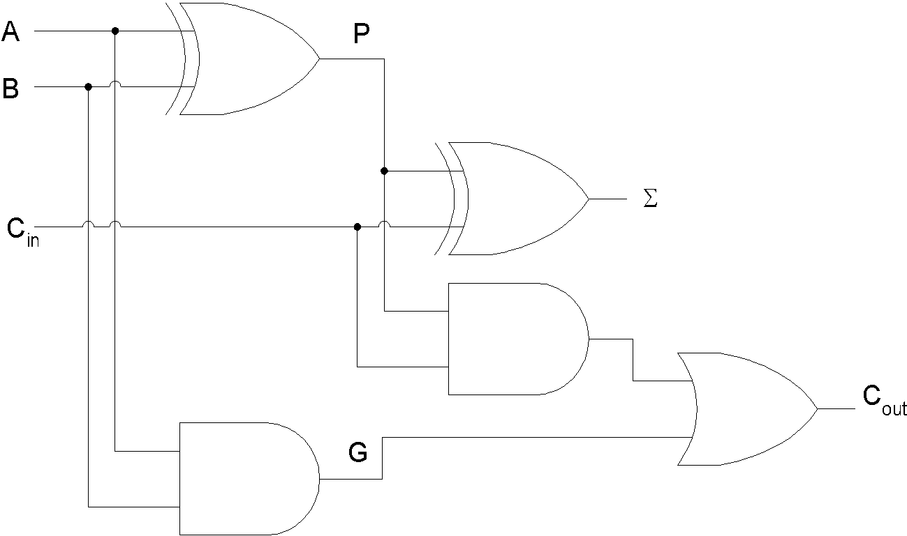
Look-Ahead Carry Circuit
Notes:
17
The P output is called the Carry Propagate.
The G output is called the Carry Generate as it generates a carry when A and B are both 1 regardless of C in.

Slide 18

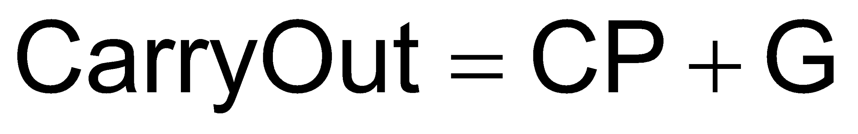
Sum & Carry Expressions

Slide 19
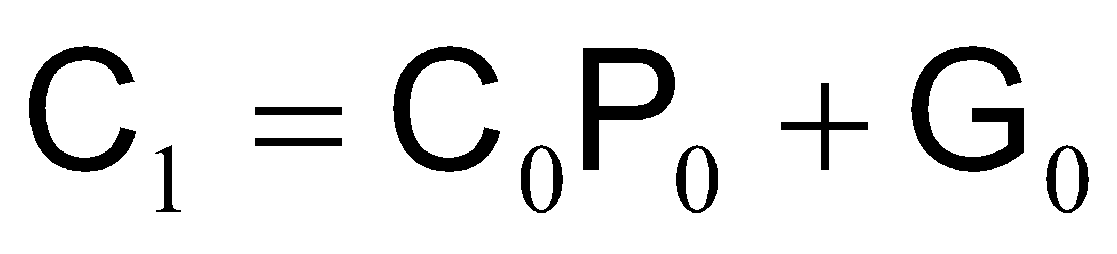
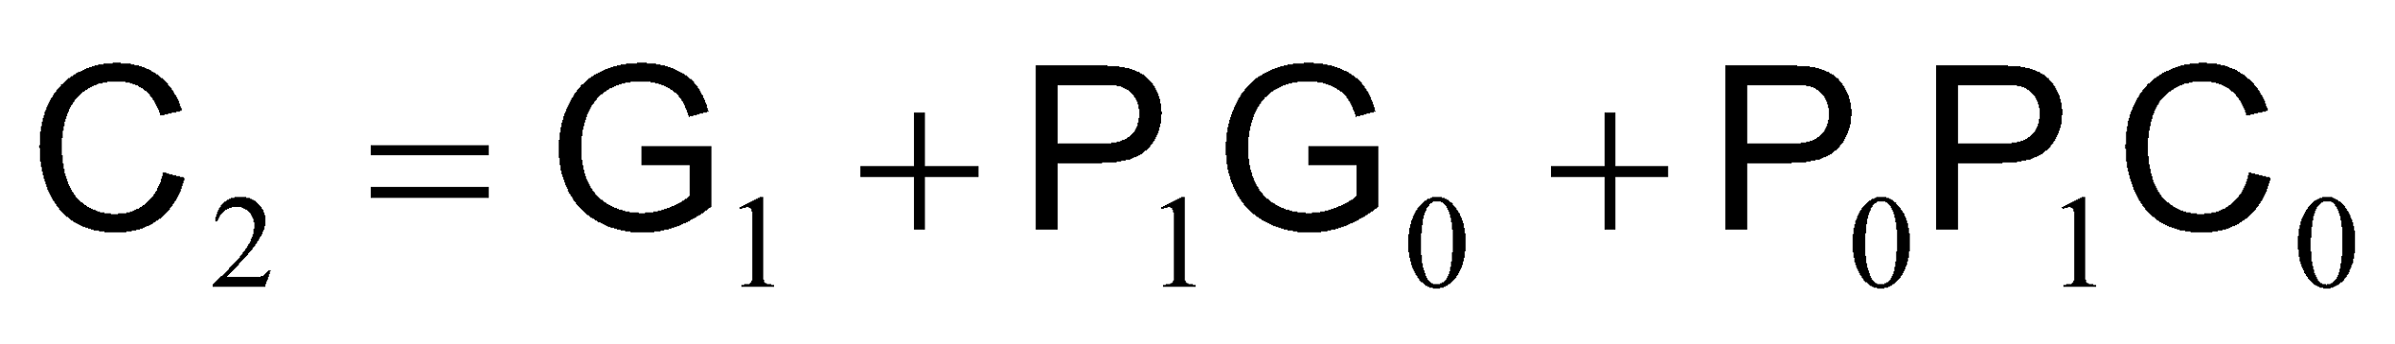
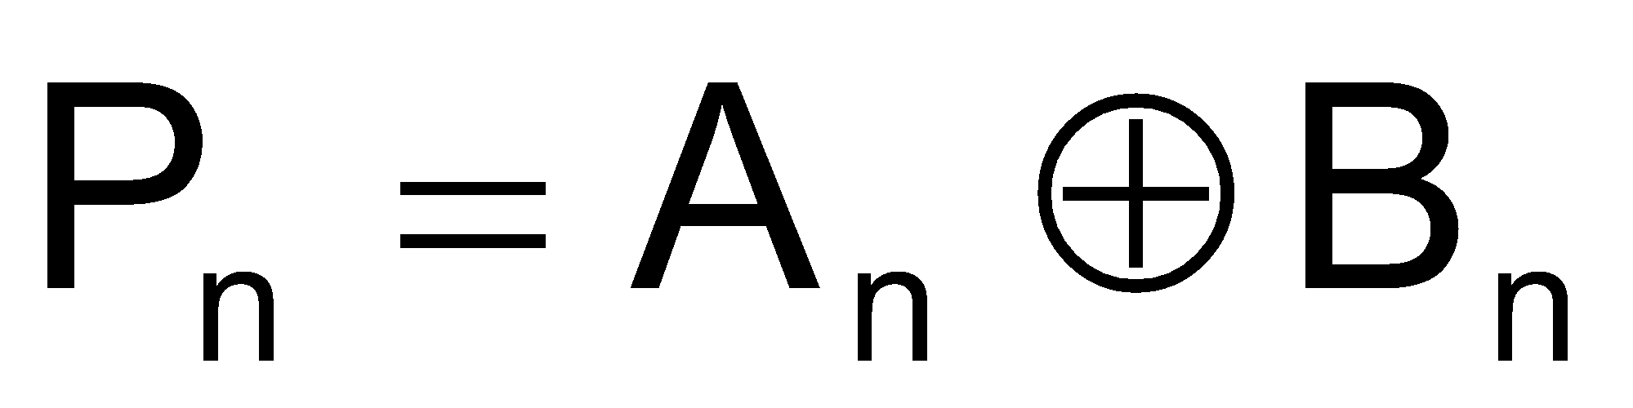
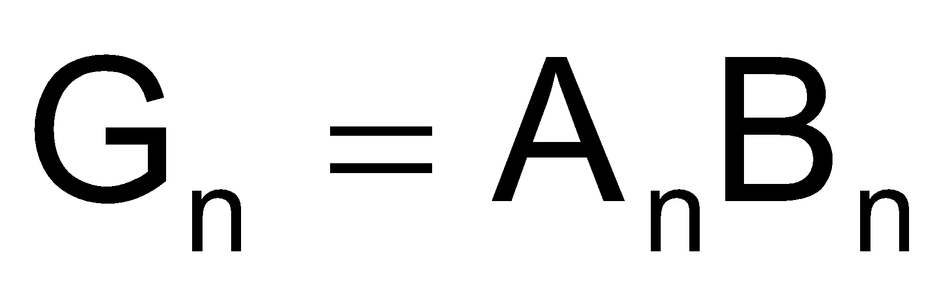
Carry Expressions

Slide 20
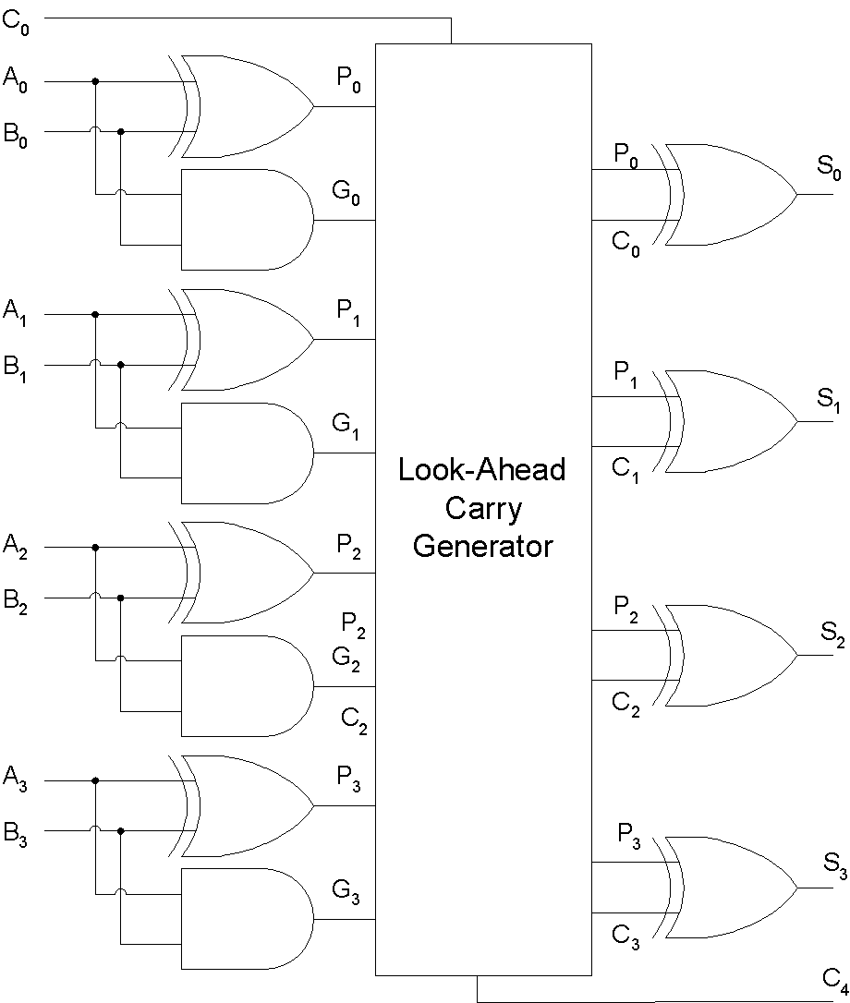
Look-Ahead Carry Generator
Notes:
20

Slide 21
MSI-Adders
74LS83A
74LS283
16-pin ICs
4-bit A input
4-bit B input
4-bit Sum output
1-bit Carry in
1-bit Carry Out

Slide 22
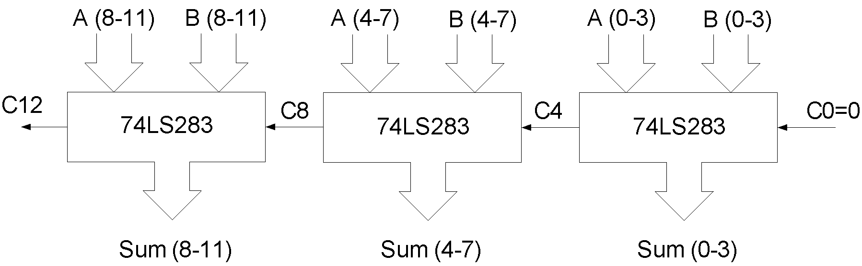
12-bit Parallel Adder
Notes:
22
The first 4-bit Adder chip on the extreme right is used to add bits 0 to 3, the least significant four bits of the two 12 bit numbers.
The second 4-bit Adder chip in the middle is used to add bits 4 to 7, the next most significant bits of the two 12 bit numbers.
Finally, the third 4-bit Adder chip on the extreme left is used to add the most significant bits 8 to 11 of the 12-bit numbers.
Similarly the 4-bit adder chip on the extreme right generates least significant Sum outputs 0 to 3.
The second 4-bit Adder chip generates Sum output for bits 4 to 7.
The third 4-bit Adder chip on the extreme left generates the Sum outputs for most significant bits 8 to 11.
The Carry out is generated by the left most 4-bit Adder. It is shown as C12
Similarly the Carry in is shown connected to the right most 4-bit adder. It is represented by C0.
Carry out of the first 4-bit Adder on the extreme right is connected to the Carry In of the 4-bit adder in the middle. It is represented as C4.
The Carry out of the middle 4-bit adder is connected to the Carry in of the 4-bit Adder on the extreme left. It is represented by C8.

